Slide 1
Real time Temperature Measurement of a System on Chip
Sharad Sirsat (549787)
Animesh Mukherjee (558741)
Giriraj Pawar (551205)
Project Lab Embedded Systems
Chemnitz, 03.07.2019

Slide 2
Table of Content
Introduction & motivation
Real time measurement of temperature
Real implementation and measurement results
Comparison with external temperature sensor
Challenges and observations
Conclusion

Slide 3
Introduction and Motivation
Measurement the temperature variations can give an overview of current state of the system in Industries
In Wireless Sensor Networks, during two node communication, continuous data exchange causes temperature of SoC to increase
SoC may show non-stable behaviour. This variation may lead to certain changes in the obtained results of relative data measurement and also stability of system may violate.
It is critical to study the internal temperature variation of the circuit

Slide 4
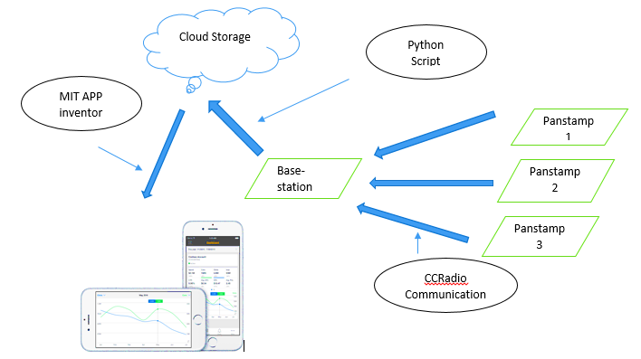
Real time measurement of temperature
Monitoring Temperature of System on Chip and comparing with ambient temperature
Temperature data is transmitted from Panstamp to base station and then to Android Application.
Hardware:
Panstamp_1(Modem)
Panstamp_2(Beacon)
Software : Android Application
Cloud Storage:
Firebase
overview of an IoT temperature measurement system

Slide 5
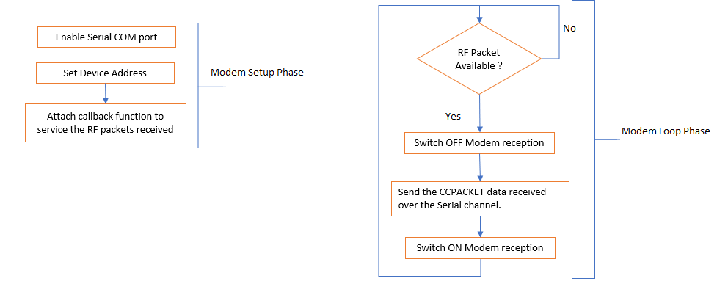
Real time measurement of temperature
Flow chart of base station node

Slide 6
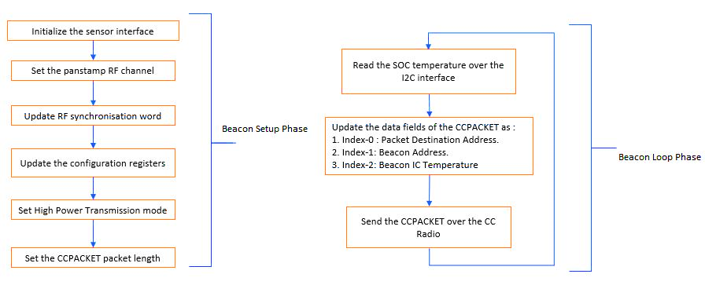
Real time measurement of temperature
Flow chart of target node

Slide 7
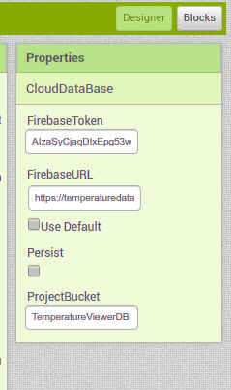
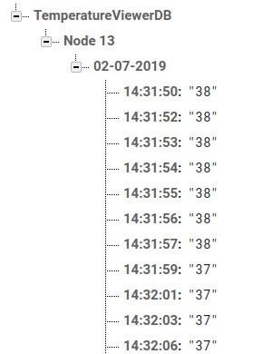
Real time measurement of temperature
Database
Firebase is the real-time cloud services provided by Google to read and write data in real time in Cloud
Database integration
Database sample

Slide 8
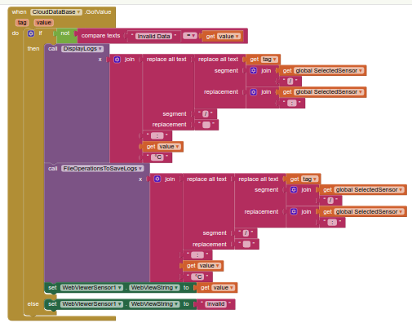
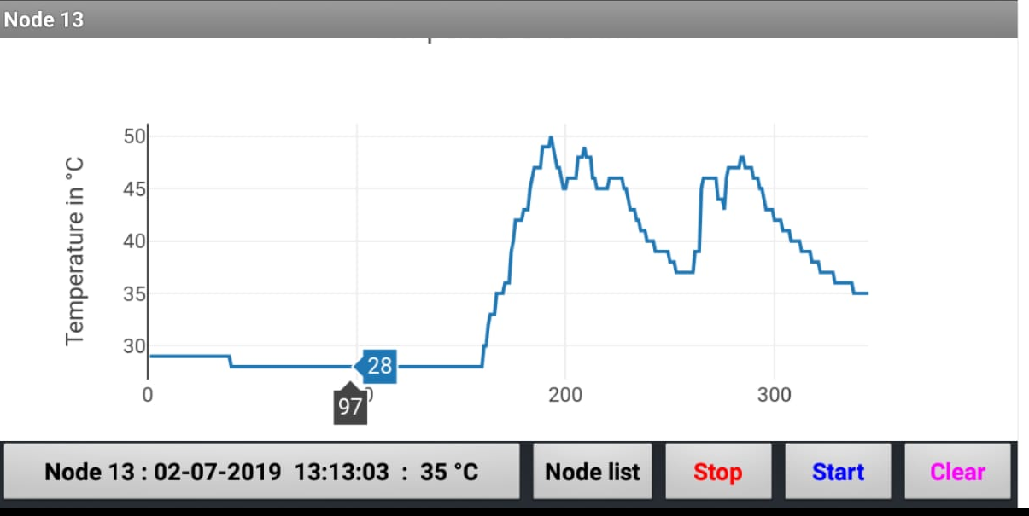
Real time measurement of temperature
Android application
"MIT App inventor 2" uses block-based coding method
It uses graphical interface to drag and drop visual objects
Integrated with Firebase for cloud services
Android Application Code-block
Interface of Android application

Slide 9
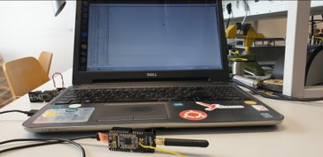
Real implementation and measurement results
Normal room temperature

Slide 10
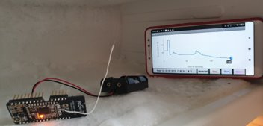
Real implementation and measurement results
Freezing temperature
Approximate Response Time for freezing: 1°C per second
Approximate Response Time for coming back to Normal Temperature: 1°C per second

Slide 11
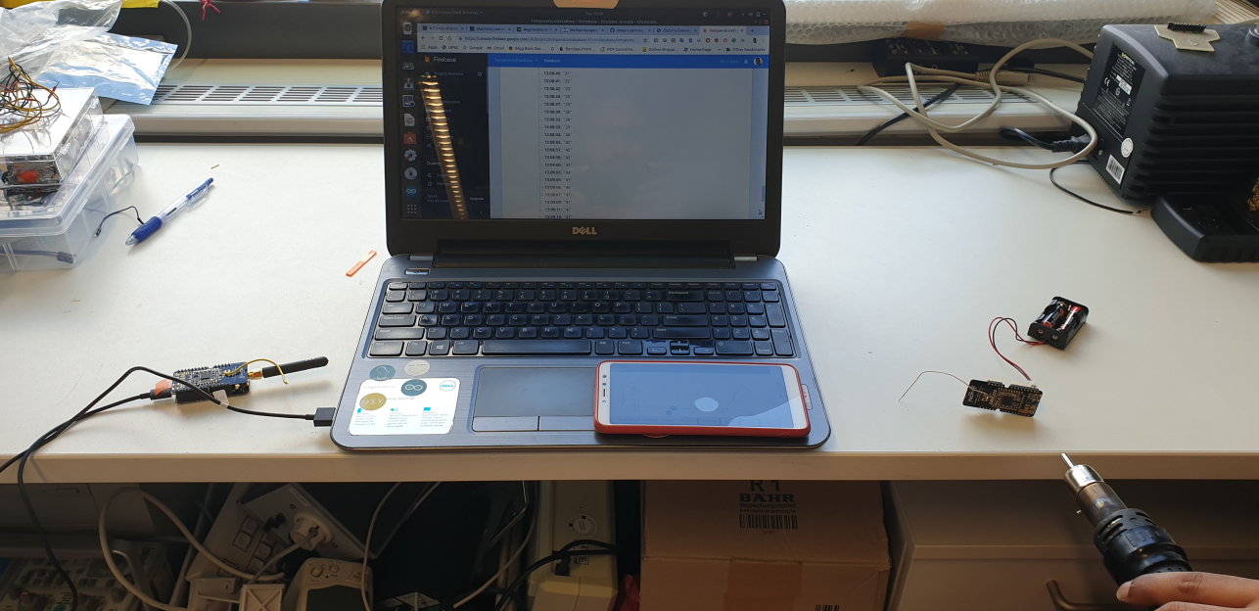
Real implementation and measurement results
Heating temperature
Approximate Response Time for heating: 5°C per second
Approximate Response Time for coming back to normal temperature: 1°C per 30 Seconds

Slide 12
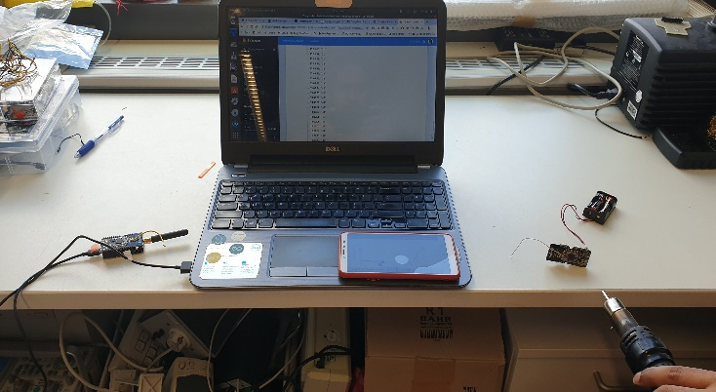
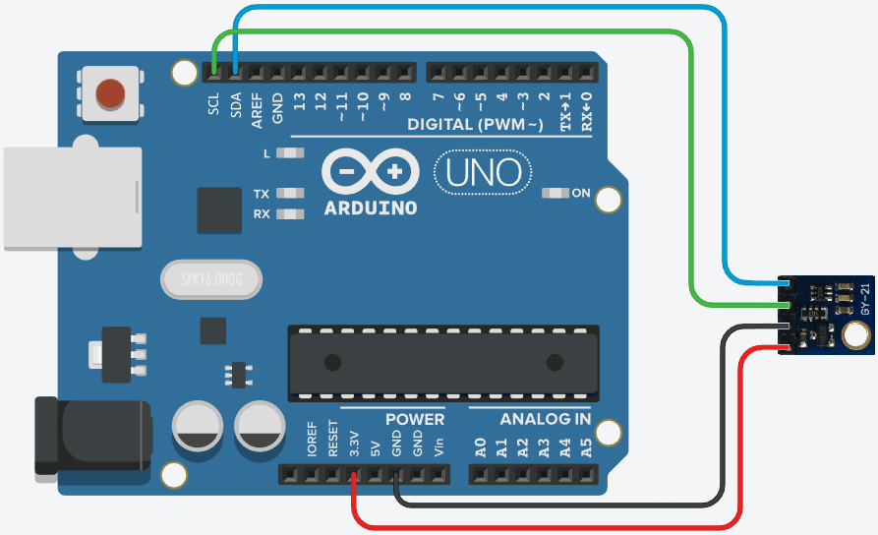
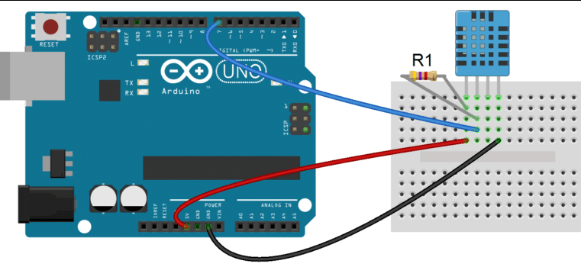
Comparison with external temperature sensor
SI7021 with PanStamp
SI7021 with Arduino UNO
DHT11 with Arduino UNO

Slide 13
Comparison with external temperature sensor
Comparison of internal and external temperature sensors at normal temperature.

Slide 14

Challenges & Observations
SWAP Protocol was not any more supported and maintained
Real time data synchronization of temperature data
Use of plotly.js JavaScript library to plot a real time graph

Slide 15
Conclusion
Use of panStamps for measuring real time temperature is precise or sensitive to a given change in SOC temperature
IoT application enables to have a continuous and real time monitoring of both internal and ambient temperature of the respective system
There will be slight difference in the measurement of Internal SoC and External temperature sensor
External and Internal SoC SI7021 sensor is more sensitive than DHT11 temperature sensor. DHT11 sensor is more sensitive to humidity

Slide 16
References
[1] L. A. Guildner and W. Thomas, “The Measurement of SOC Temperature,” Temperature. Its Measurement and Control in Science and Industry (American Institute of Physics, New York, 1982), Vol. 5, pp. 9–19, Available: https://aip.scitation.org/doi/10.1063/1.1305516 [Accessed May 10, 2019].
[2] M. Biebl, G. Brandl, and R. T. Howe, “Young’s modulus of insitu phosphorus-doped polysilicon,” in Proceedings of the 8thInternational Conference on Solid-State Sensors and Actuators, and Eurosensors IX, pp. 80–83, Stockholm, Sweden, Jun 1995. Available: https://www.hindawi.com/journals/js/2016/8624817/ref/ [Accessed May 10, 2019]
[3] G. L. Pearson,W. T. Read Jr., andW.L.Feldmann, “Deformation and fracture of small silicon crystals,” Acta Metallurgica, vol. 5, no. 4, pp. 181–191, 1957, Available: https://link.springer.com/chapter/10.1007/978-94-007-1013-9_1 [Accessed May 10, 2019]
[4] E. A. de Vasconcelos, S. A. Khan, W. Y. Zhang, H. Uchida, and T. Katsube, “Highly sensitive thermistors based on high-purity polycrystalline cubic silicon carbide,” Sensors and Actuators A:Physical, vol. 83, no. 1–3, pp. 167–171, 2000.
[5] ] J. B. Casady, W. C. Dillard, R. W. Johnson, and U. Rao, “A hybrid 6H-SiC temperature sensor operational from 25∘C to 500∘C,” IEEE Transactions on Components, Packaging, and

